Slide 1
Welding, Cutting and Brazing
Standard 29 CFR Part 1910.251-254
Presented by: Barton Insurance Group LLC
© 2006, 2020 Zywave, Inc. All rights reserved.

Slide 2
Learning Objectives
During this training program, participants will learn about:
The hazards of welding, cutting and brazing
What personal protective equipment (PPE) is required when conducting hot work
Safety procedures related to welding, cutting and brazing
Instances where hot work permits are required
How to handle compressed gas cylinders

Slide 3
What Are Welding, Cutting and Brazing?
Welding involves joining materials (e.g., metals or thermoplastics) using high heat to melt the parts together, causing fusion.
Cutting involves separating metal using heat.
Brazing involves joining two metals by heating and melting a filler metal.
We will refer to these processes as “hot work” throughout this presentation.

Slide 4
Physical Hazards
The heat involved in hot work processes can create serious hazards, including:
Fire hazards—Sparks, slag, flames and heat from hot work can cause accidental fires. What’s more, heat from hot work can be conducted through pipes and ducts, which can start fires in different rooms or on other floors in a building.
Explosion hazards—Fuel gasses used in hot work can explode when ignited in a closed space. Additionally, oxygen can cause flammable and combustible liquids to burn with explosive force.

Slide 5
Personal Health Hazards
Hot work can be hazardous to your health and safety in the following ways:
Contact with hot equipment or material can cause severe burns.
UV rays from hot work can cause serious eye damage, as well as burns if the skin is not protected.
High voltage welding leads, supply current leads or power tool cords can all cause electric shock.

Slide 6
Personal Health Hazards (Continued)
Hot work can create a number of dangerous gasses and fumes, including:
Welding gasses—Inert gasses (e.g., argon) used in some types of hot work can be asphyxiants in high concentrations.
Welding fumes—Fumes created by hot work can be toxic:
Metal fume fever—Welding fumes can contribute to metal fume fever, which is caused by the inhalation of metal oxides. Symptoms of metal fume fever can include fevers, headaches and nausea.
Hexavalent chromium—Hexavalent chromium fumes can be produced by welding. Long-term exposure to these fumes can cause cancer.

Slide 7
Fire Prevention
Hot work should only be done in one of two scenarios—in designated areas or under a hot work permit:
Designated areas are designated for hot work. These areas are often either production hot work or maintenance areas where hot work is done frequently.
The key to preventing fires is to ensure the work area is clear of flammable and combustible materials. If this can’t be accomplished, the work area can’t be used as a designated area.

Slide 8
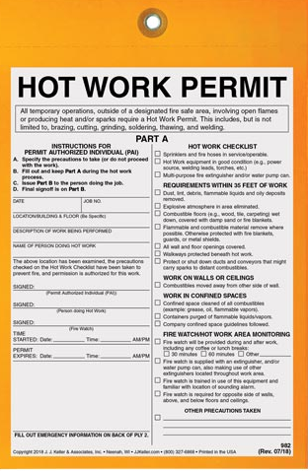
Hot Work Permit
Hot work permits are used for temporary hot work jobs. The following are some considerations related to hot work permits to keep in mind:
In order for a permit to be valid, conditions related to removing combustibles and selecting an individual as a fire watch must be met.
Fire watches must be trained individuals with a fire extinguisher who are capable of putting out a potential fire.
Once a hot work permit has expired, it must be turned in.

Slide 9
PPE – Eye and Face Protection
During hot work, eye and face protection can protect you from flying particles and harmful rays
Eye and face protection, like welding masks, must be selected to protect against the type of welding being performed.

Slide 10
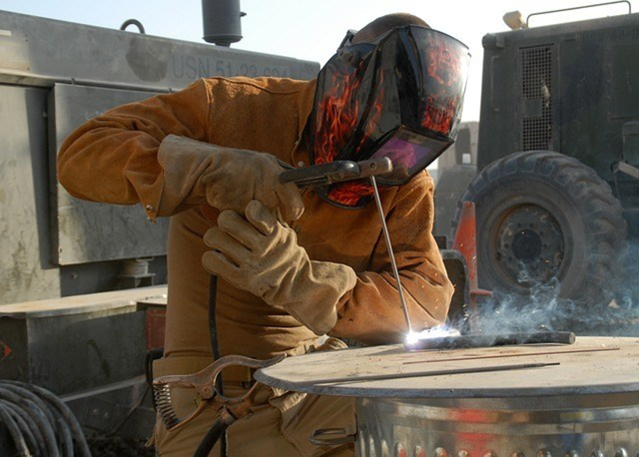
PPE – Hand and Body Protection
UV rays in hot work can damage your eyes and skin. To protect yourself:
Ensure your skin isn’t exposed during hot work.
Use flame-retardant clothing, as slag can burn through normal clothes.
Wear the proper gloves to prevent cuts and burns.

Slide 11
Ventilation
Ventilation is critical to controlling exposures related to hot work gases and fumes. The following are some considerations as it relates to ventilation:
The key to good ventilation is to draw fumes away from the breathing zone.
When welding on carbon steel, a naturally well-ventilated area allows for dispersion of fumes. When welding on stainless steel or galvanized steel, additional ventilation may be necessary.
A ventilation system, such as a hood or a smoke eater, can provide additional protection.

Slide 12
Compressed Gas Cylinders
Compressed gas cylinders may be extremely pressurized. As such, dropping or striking a compressed gas can cause serious injuries.
When moving a compressed gas cylinder, never roll it. Instead, use a cart or dolly.
Whenever you transport a cylinder, the cap must be properly in place.

Slide 13
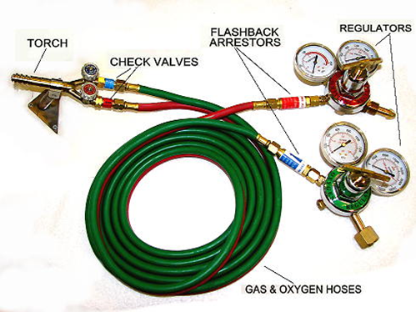
Compressed Gas Cylinders (Continued)
Never let oxygen come into contact with flammable liquids, as this will accelerate burning.
Inspect hoses for damage before hot work.
Ensure valves and flash back preventers are in place to prevent mixing in the hose or cylinders.

Slide 14
Compressed Gas Cylinders (Continued)
Open the fuel with the torch facing away from you.
Use a flint striker to light torches—nothing else.
Open oxygen slowly.
Close oxygen at the torch first and the fuel second when shutting down.
Bleed the lines after releasing pressure.

Slide 15
Electric Cords and Leads
Inspect all power cords and leads for intact insulation and connectors.
Check all connectors to ensure they are tight.
Route cable out of wet areas, and be sure that workers are not standing in water. Keep cables out of walkways to prevent trips and falls.
Never coil or loop a cable around your body. Uncoil cables and position them on the working surface.
Be sure that ground is established with a true “earth” (e.g., the ground, structural steel or a water main).
Attach the ground lead to the work piece or as close to it as possible.

Slide 16
Summary
Welding, cutting and brazing are potentially hazardous undertakings.
Persons who practice these crafts must remember that fires and injuries are always possible.
Safe and skilled workers follow the rules and stay tuned into the work area to prevent accidents.

Slide 17
For More Information
For more information regarding welding, cutting, brazing or other safety issues, please contact:
Barton Insurance Group LLC
www.bartoninsurancegroupllc.com
615.806.1265

